Slide 1
Design Patterns
By Archana

Slide 2
Software Design Patterns
What are Design Patterns?
Design patterns are reusable solutions to common problems in software design
Design patterns provide a standard terminology and are specific to particular scenarios.
Why we need Design Patterns?
Reusability: Patterns can be applied to different projects and problems, saving time and effort in solving similar issues.
Improve Code Quality: Design patterns help in creating code that is easier to understand, maintain, and extend
Efficiency: By using established patterns, developers can avoid reinventing the wheel, leading to faster and more reliable development.

Slide 3
Types of Software Design Patterns
Creational Design Pattern
Structural Design Pattern
Behavioral Design Pattern

Slide 4
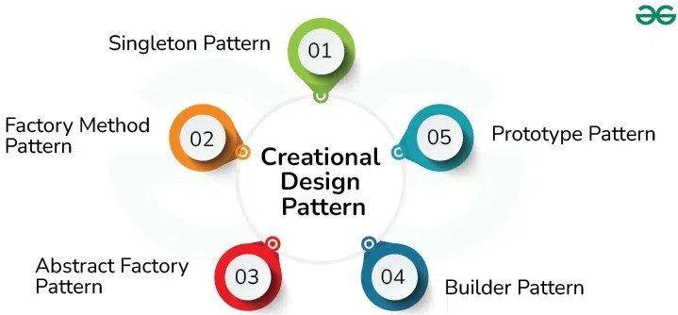
Creational Design Patterns
Creational Design Pattern abstract the instantiation process. They help in making a system independent of how its objects are created, composed and represented.

Slide 5
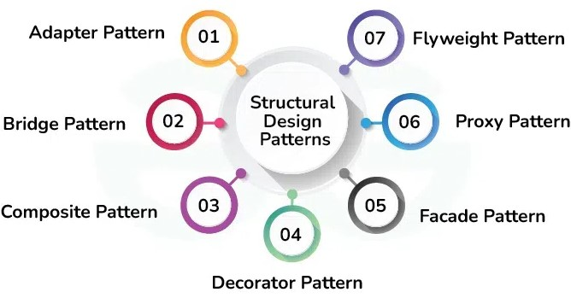
Structural Design Patterns
Structural design patterns deal with object composition, ensuring that objects are structured in a way that optimizes flexibility and efficiency

Slide 6
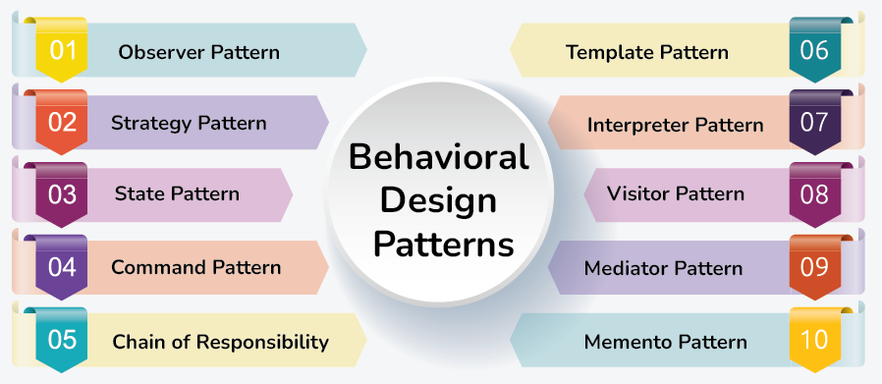
Behavioural Design Patterns
Behavioral patterns describe not just patterns of objects or classes but also the patterns of communication between them.
These patterns characterize complex control flow that’s difficult to follow at run-time.

Slide 7
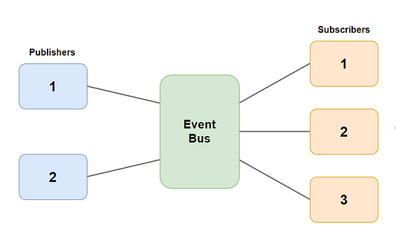
Pub/Sub (Publish-Subscribe) Pattern
React implements a form of the Pub/Sub pattern in its state and event handling mechanisms. Components can publish changes (state updates) and others can subscribe to these changes (through props or state).
In the context of React's useState, useEffect, and context APIs, components "publish" state changes, and those changes propagate to any component "subscribed" to them via props.
Based on Day/Night toggle we have to show other light controls on/off, here day/night toggle is publisher and other lights works as subscribers.
Real-world Example:Notifications, News feed updates, Chat and Messenger, Real-time commenting and likes

Slide 8
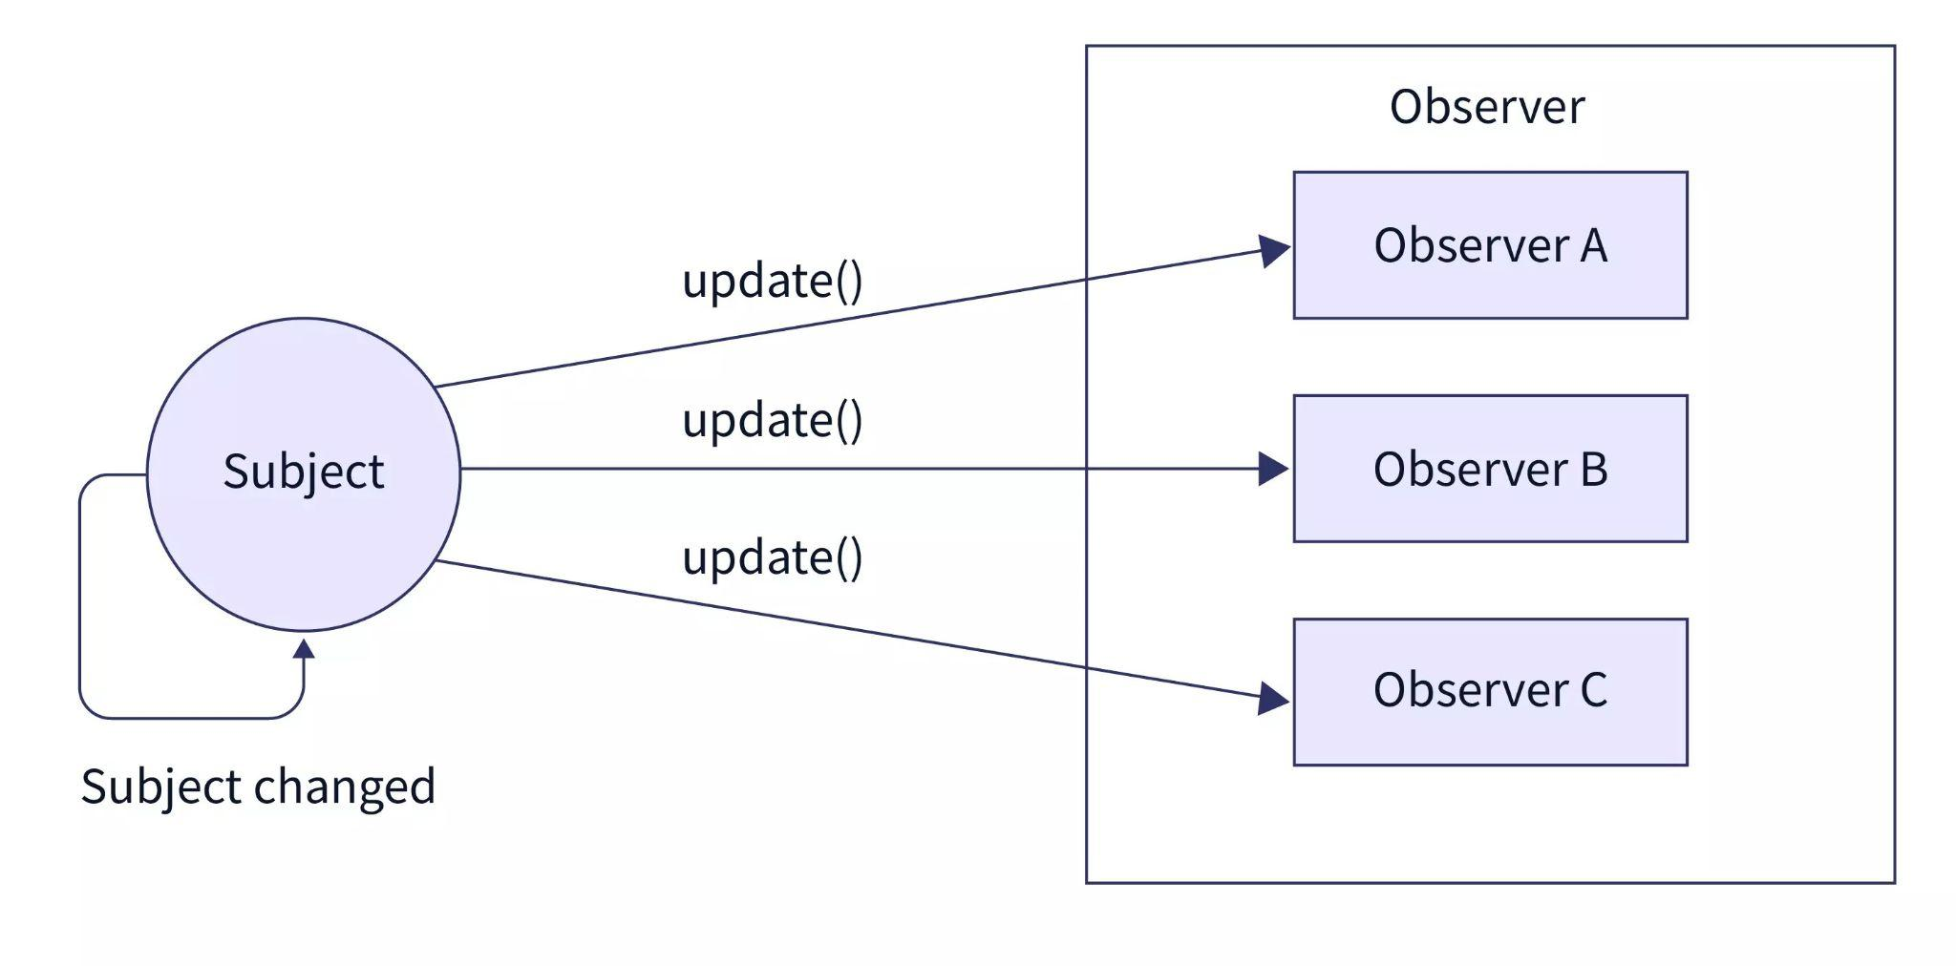
Observer Pattern
React implements a variation of the Observer Pattern in its component lifecycle. In the Observer Pattern, objects subscribe to events or changes and respond accordingly.
In React, components observe state and props. Whenever a state or prop changes, React re-renders the component, making it an observer of those changes.
This pattern is useful for syncing React state with the 3D scene. When we turn on/off light from UI, based on the value we have to update light object inside scene
Real-world Example: In a Facebook app, the Observer Pattern can be seen in how the news feed updates in real-time when new posts or notifications arrive. Components observe changes in state and re-render accordingly.

Slide 9
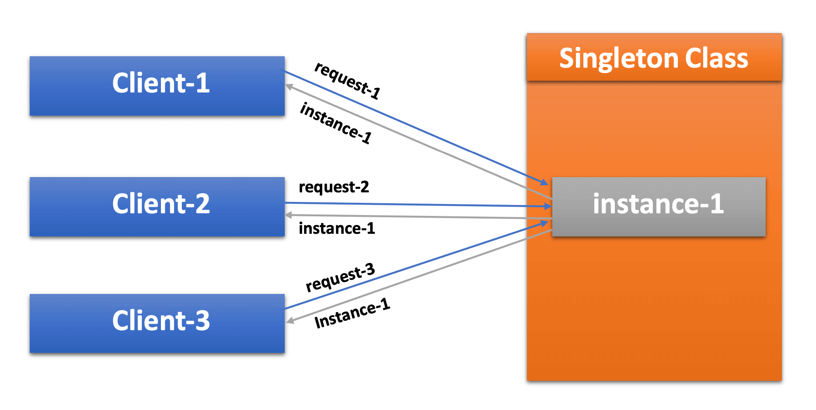
Singleton Pattern
The Singleton design pattern ensures that a class has only one instance and provides a global point of access to it
In React, the Singleton pattern is used implicitly by the ReactDOM object.
Similarly, each component is, by definition, a singleton. React ensures that the same instance of a component is reused for rendering updates unless it’s explicitly re-mounted.
We can use it for login, to make sure only one user has logged in and the cart/other details are related to that user.
Singleton pattern can be used when we select or show 360spins of object, only one has to be selected at a time

Slide 10
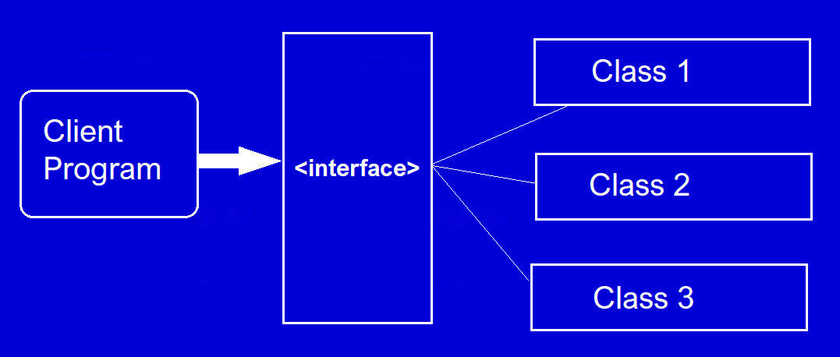
Factory Pattern
The Factory Pattern is implicitly used when React creates component instances. Every time a component is rendered, React uses a factory pattern to instantiate that component.
In JSX, when you write <Component />, you are essentially invoking a factory that creates an instance of that component.
The Factory Method pattern can be used to encapsulate the creation logic of the components.
Real-world Example: A Notification Factory in Facebook that creates different types of notifications (like friend requests, messages, tags) depending on the user’s activity. Each notification type may have a different UI or behavior, but all are created through a common factory function, which simplifies the logic.

Slide 11
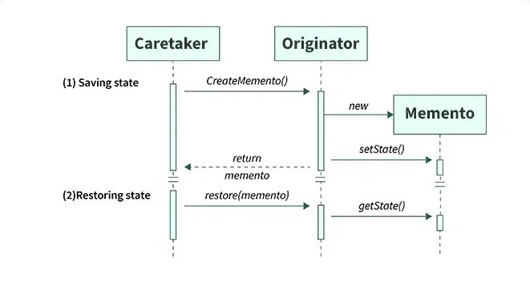
Memento pattern
It allows you to save and restore the state of an object to a previous state, providing the ability to undo or roll back changes made to the object.
This pattern is particularly useful in undo/redo functionality, history tracking,versioning and state rollback
Real World Example: In a Facebook app, users may write and edit posts. The Memento pattern can be applied to provide an undo/redo feature for the post editor, allowing users to revert to previous versions of their content. Similarly, they could redo changes they initially undid.

